Slide 1
Accountability – Title II known as Administrative Simplification Provisions
Includes 5 rules:
  Privacy Rule
  Security Rule
  Transactions and Code Sets Rule
  Unique Identifiers Rule
  Enforcement Rule

Slide 2
Unique Identifiers Rule
HIPAA establishes and requires unique identifiers for:
  Employers – EIN, or Employer Identification Number, is issued by the Internal Revenue Service and is used to identify employers in electronic transactions.
  Providers – NPI, or National Provider Identifier, is a unique 10-digit number used to identify health care providers.
  Patients – There is no adopted standard to identify patients – For example SSN was used in past, but not anymore

Slide 3
Accountability – Title II known as Administrative Simplification Provisions
Includes 5 rules:
  Privacy Rule
  Security Rule
  Transactions and Code Sets Rule
  Unique Identifiers Rule
  Enforcement Rule

Slide 4
Enforcement Rule
Lays out procedures for investigations, penalties and hearings when fraud is suspected

Slide 5
Penalties – Based on four culpability tiers established by 2009 HITECH Act
Tier 1: No Knowledge
Tier 2: Reasonable Cause
Tier 3: Willful Neglect – Corrected
Tier 4: Willful Neglect – Not Corrected
Notes:
Examples of each tier

Slide 6
Penalties – On 4/26/19, HHS capped fines
Tier | Penalty
1 | $100-$50,000 per violation, capped at $25,000 per year the issue persisted
2 | $1,000-$50,000 per violation, capped at $100,000 per year the issue persisted
3 | $10,000-$50,000 per violation, capped at $250,000 per year the issue persisted
4 | $50,000 per violation, capped at $1.5 million per year the issue persisted
Notes:
This change in the agency’s interpretation of the HITECH Act and its exercise of enforcement discretion comes as MD Anderson Cancer Center in Texas is asking the Fifth Circuit to overturn a ruling by an HHS administrative law judge upholding a $4.3 million HIPAA penalty. MD Anderson is also challenging HHS’s authority to impose the CMP in a suit filed against the HHS Secretary in federal district court. Among other arguments, MD Anderson asserts that the Secretary exceeded his authority by imposing a CMP beyond the statutory caps. MD Anderson argued in its complaint that under the statute, “Reasonable Cause” violations OCR alleged in the case must be capped at $100,000 per violation per year and that the Secretary erroneously imposed the highest level penalty cap of $1.5 million, which renders the culpability-specific caps in the law meaningless “in violation of basic statutory construction principles.” HHS’s newly revised interpretation of the annual cap for a “Reasonable Cause” violation to $100,000 aligns with MD Anderson’s position. OCR Director Roger Severino told reporters Friday that the announcement is not connected with the ongoing MD Anderson cases.

Slide 7

Possible Jail Time
Unknowingly or with Reasonable Cause: Up to one year
False Pretenses (purposefully attempting to cover up): Up to five years
Personal Reasons or to Commit Fraud or a Crime with Malicious Intent: Up to ten years

Slide 8
Accountability – Title II known as Administrative Simplification Provisions
Includes 5 rules:
  Privacy Rule
  Security Rule
  Transactions and Code Sets Rule
  Unique Identifiers Rule
  Enforcement Rule

Slide 9
Types of Fraud
  Billing for services not rendered
  Misrepresenting services as Medically Necessary
  Falsifying Medical Records for the purpose of obtaining payment
Notes:
Doctors wanted to get the maximum amount of payment so they were commiting fraud…saying that patients had a certain sickness/ disease to get the most money out of the insurance. Ie- mds were billing for bacterial pneuomnia and In the beginning didn’t have to send support documents for services that were billed for. Medicare ended up catching on and started to look into these fraudulent claims.

Slide 10
Fraud: Billing for Services not Rendered
A clinical lab receives orders from a physician for specific lab tests. The lab performs and bills for tests indicated on the order, but then also bills for additional tests that were not ordered or rendered.

Slide 11
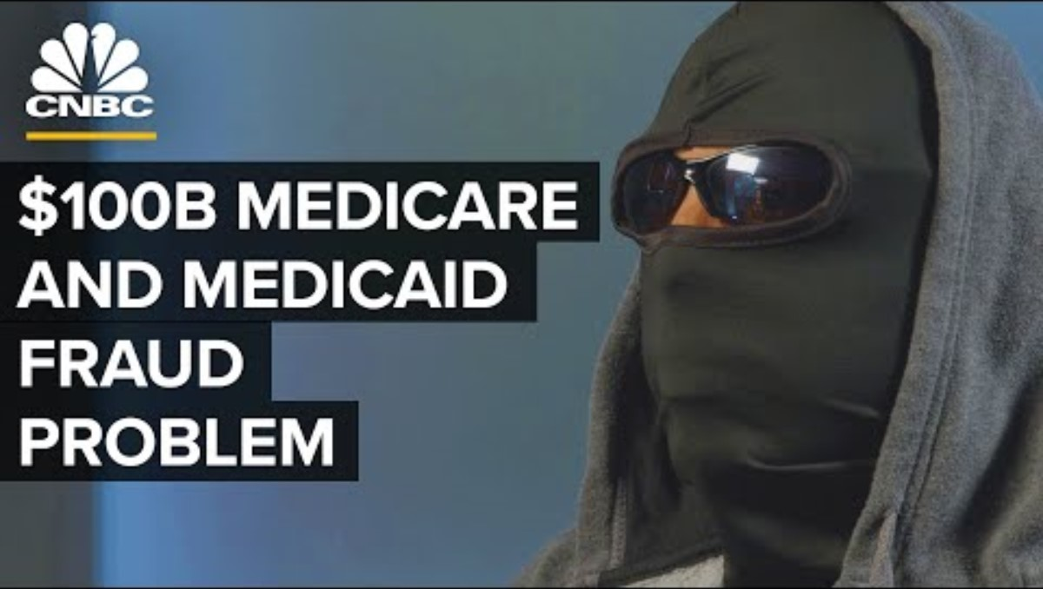
Medicare Fraud Example

Slide 12

Services are Not Medically Necessary
A group of nursing home patients are offered free exercise classes. The free services are billed to Medicare as covered physical therapy at a Rehab center.

Slide 13

Falsifying Medical Records
A patient recruiter convinces unsuspecting beneficiaries to reveal their Medicare numbers to him. The recruiter then sells the Medicare numbers to a fictitious provider who bills for services never furnished and creates medical records to support the services provided.
Notes:
Sneaker example

Slide 14
Waste, Fraud & Abuse Laws
False Claims Act 1863 (“Lincoln Law”)
  Primarily used against defense contractors until 1990s
Fraud Enforcement and Recovery Act 2009
Patient Protection and Affordable Care Act 2010
Mail & Wire Fraud
Anti-Kickback
Stark
HIPAA
Notes:
False claims act aka Lincoln law….used tax payer money to buy arms but when the guns came there was just lead, no guns. Anyone who commits a fraudulet claim that says when they’re giving the gov better be what the contract is. False claims to the gov...can go to jail. Is that act that says you’re commiting a false claim.
Fraud enforcement and recovery act is the newer version of falst claims act.
Electronic submission is wired fraud.
Anit-kick back- when the doctor asks “what’s in it for me?” if i do this then how will i get reimbursed....can be baseball tickets, trips, etc....
Stark- anti physician referall law. If a md or their family has an invested interest in that referral can’t refer them.
Ie- if an orthopedic md gave his patients to his wife who is a PT….can’t do that.
Hipaa is law that made that made fraud punishable and go to jail...punishable that one can go to jail

Slide 15
2024 Largest breaches
Regulated Entity | Individuals Affected | Cause of Breach
Change Healthcare, Inc. | 100 Million | MFA not enabled / Ransomware
Kaiser Foundation | 13.4 Million | Tracking tech on web page / data sent included IP address
Ascension Health | 5.6 Million | Malicious file downloaded by employee / Ramsomware
HealthEquity | 4.3 Million | Malicious software on vendor laptop to access data on SharePoint

Slide 16
2024 Penalty Examples
Year | Covered Entity | Amount | Penalty Type
2025 | Deer Oaks – The Behavioral Health Solution | $225,000 | Settlement
2025 | Comstar LLC | $75,000 | Settlement
2025 | BayCare Health System | $800,000 | Settlement
2025 | Vision Upright MRI | $5,000 | Settlement
2025 | Comprehensive Neurology | $25,000 | Settlement
2025 | PIH Health | $600,000 | Settlement
2025 | Guam Memorial Hospital Authority | $25,000 | Settlement

Slide 17
The Health Information Technology for Economic and Clinical Health (HITECH) Act - 2009

Slide 18
What is the HITECH Act?
Enhanced Privacy & Security Protections
  Increased legal liability for non-compliance
  Greater enforcement.
Created a national health information infrastructure (Meaningful Use)
  Used monetary incentives to encourage widespread adoption of electronic health records
Notes:
Was to create a national database, where multiple databases/ products could speak to each other. Move forward with a EHR.... That a patients history would be accessable throughout the whole country.
Marrying of healthcare and technology. Would be able to use that money for “meaningful use”
There are no “take backs” once something sends or is closed out.

Slide 19
HITECH: Enhanced Privacy and Security Protections
Tiers - Penalties
Breach Notification
Enhanced Business Associate Requirements
Access to Electronic Health Records
Right to Restrict Disclosures
Accounting for Disclosures

Slide 20
Change in Penalties by Tier
  Max Penalty Change – all tiers set at $1.5 million ($2.06 million inflation adjusted in 2024) per year originally
  Max Penalty Change per Year in 2019 via "enforcement discretion" (as of 2024)
    Tier 1: $34.4k
    Tier 2: $137.8k
    Tier 3: $344.6k
    Tier 4: $2.06 million

Slide 21
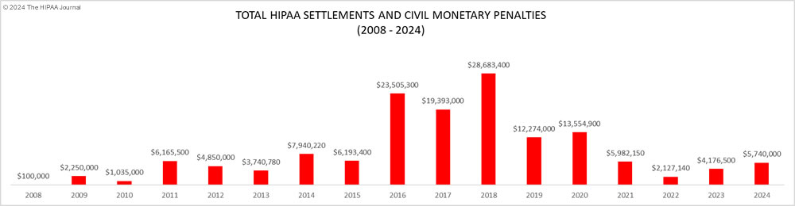
Maximum Penalties by Year

Slide 22
Breach Notification Regulation
Breach Notification Standards (to persons effected by breach):
  Notification must be made without reasonable delay and no later than 60 days of discovery of breach
  If 500 or more individuals effected – Prominent media outlets must be notified
Notes:
AVS example

Slide 23
HHS must be Notified of all Breaches
Immediately if breach involves more than 500 individuals
Annually for all other breaches

Slide 24
HHS must be Notified of all Breaches
Notice to HHS must include:
  A description of the breach, including the date of the breach and date of discovery;
  The type of PHI involved (such as full name, Social Security number, date of birth, home address or account number);
  Steps individuals should take to protect themselves from potential harm resulting from the breach;
  Steps the Covered Entity is taking to investigate the breach, mitigate losses and protect against future breaches; and
  Contact procedures for individuals to ask questions or receive additional information, including a toll-free telephone number, e-mail address, website or postal address.

Slide 25
“Secure” Technologies
Encryption
Destruction
Using these technologies makes PHI considered “Secure” and breach notification is not needed

